Slide 1
Minimum Information About Plant Phenotyping Experiments - MIAPPE

Slide 2
Plant Phenotyping standards

Slide 3
Plant data standards: WHO

Slide 4













Interoperability in International network
National
Networks
European
Networks
Global Networks
International data standards
Web services
Minimal information
Controlled vocabularies
Trait dictionaries
MCPD
Notes:
4

Slide 5

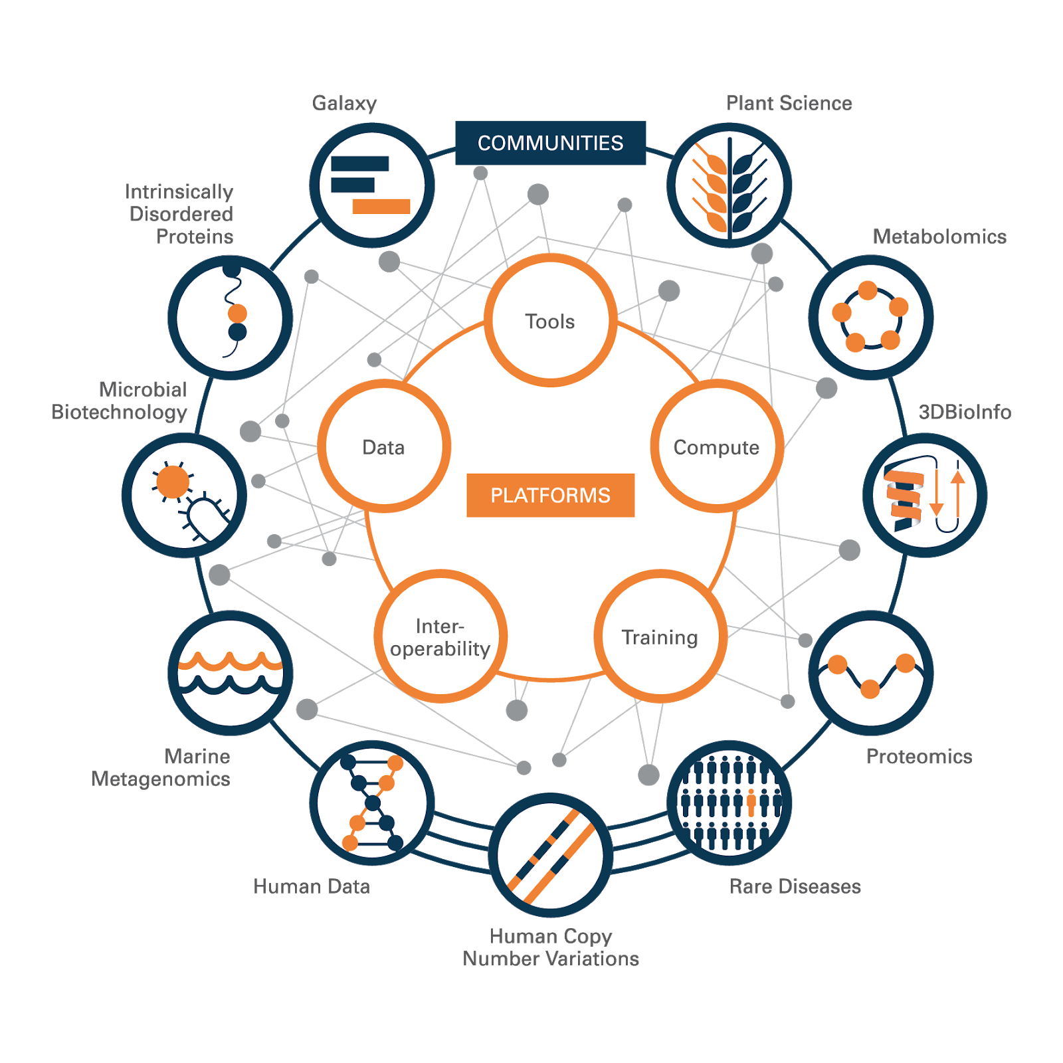
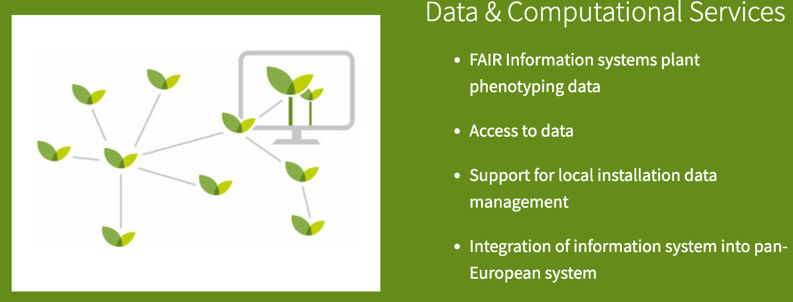
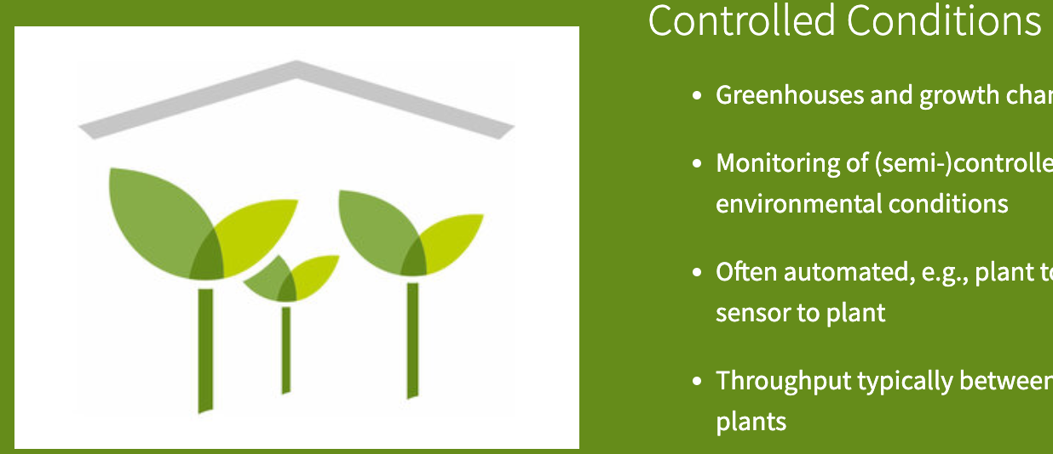
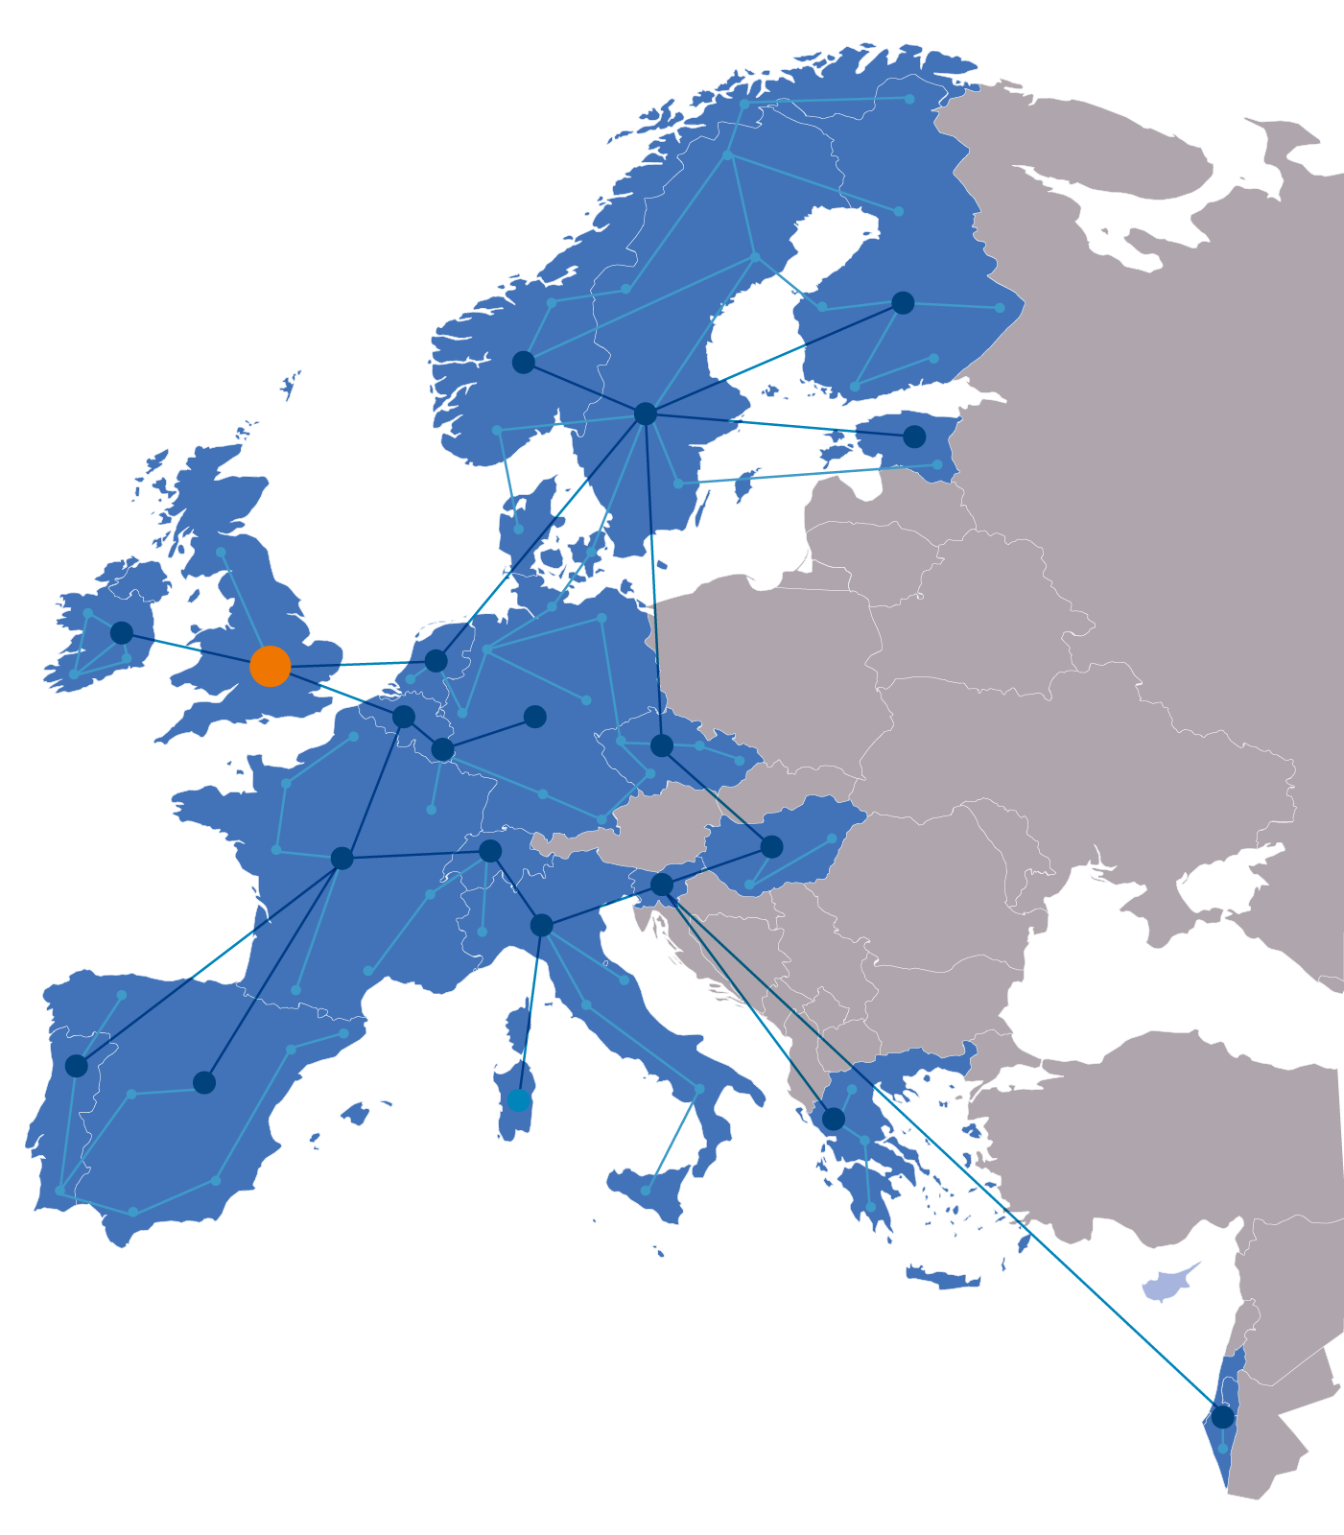
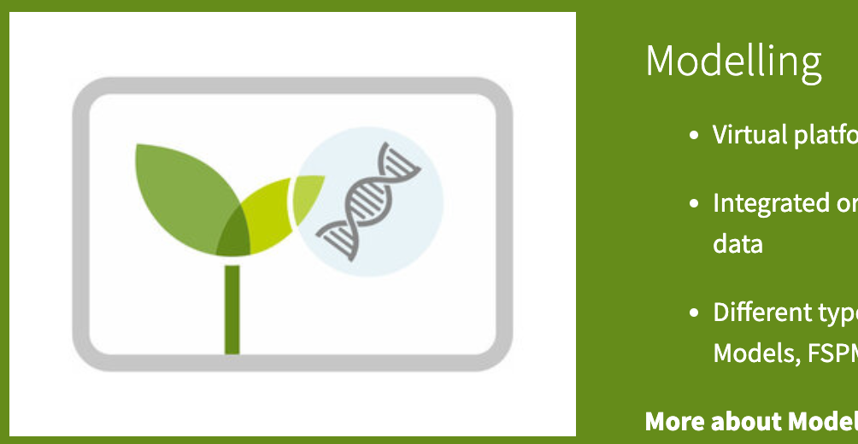
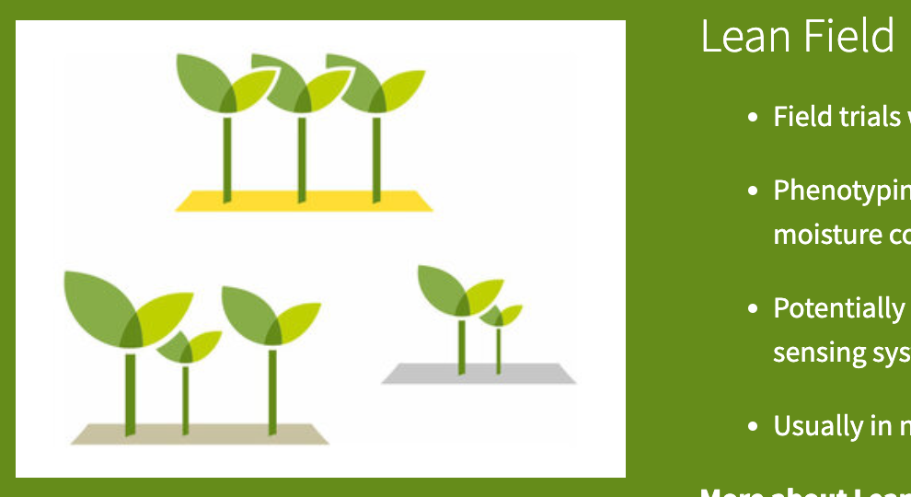
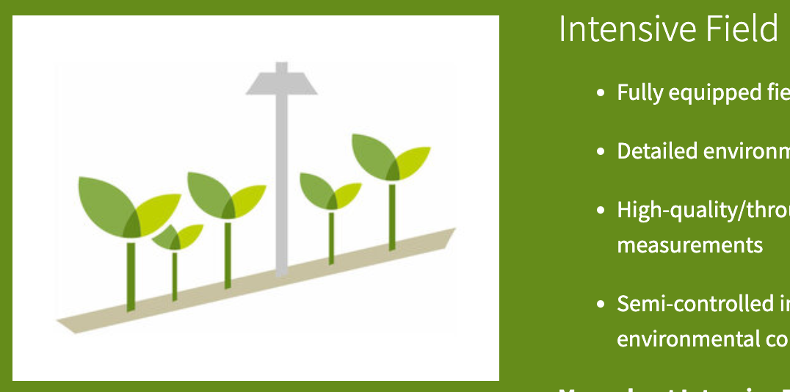
Plant data standards: contributors
Gathered to solve plant FAIR data challenges
ELIXIR
European Infrastructure for life sciences
Slovenia , France, Germany, Portugal, UK, …
https://elixir-europe.org/communities/plant-sciences
FAIR data management, software, training, …
EMPHASIS
European Infrastructure for Plant Phenotyping
France, Germany, Belgium, UK, …
https://www.plant-phenotyping.eu

Slide 6
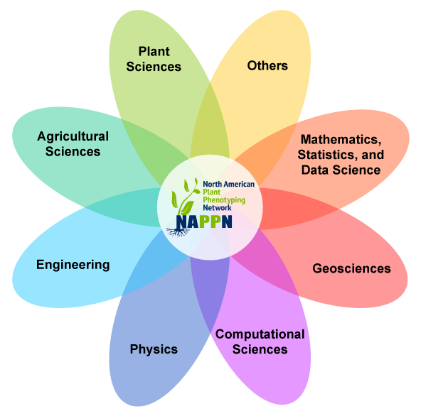


Plant data standards: contributors
Gathered to solve plant FAIR data challenges
CGIAR
Consortium of International Agricultural Research Centers
CropOntology, MIAPPE
https://www.cgiar.org/
NAPPN
North American Plant Phenotyping Network
Regional partner IPPN
https://nappn.plant-phenotyping.org/

Slide 7
Plant Phenotyping standards: WHY

Slide 8
Why should we standardize phenotyping experimental data?
To enable anyone (including yourself) to reuse it: metadata about the experiment (who did it, for what purpose, where and how)
To enable the (automatic) integration of the experimental data with other types of data: unique identification of the concepts used to link different data sets
To enable knowledge discovery: metadata about the experiment, controlled vocabularies, ontologies
Phenotype 1 = measurement on a cultivar in an environment-GPS1-time1
Phenotype 2 = measurement on a cultivar in an environment-GPS2-time2
Genotype = observed marker’s alleles on a cultivar
Climate 1 = climatic data at GPS1-time1

Slide 9

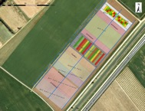
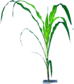
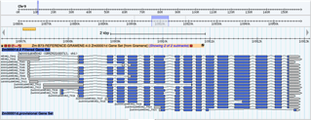
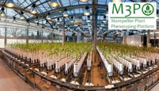


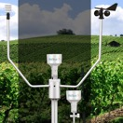
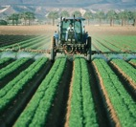
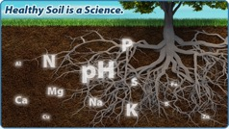
Genome / Environment / Phenome
Genetics & Genomics
Phenomics
Plant Breeding
Genetic variations by Traits
Homogenous (Mostly)
Central Access (Mostly)
Heterogenous
Distributed
Climate Change Studies
Genotype by Environment
Phenology
Environment
Heterogenous
Distributed

Slide 10


Europe open access and interoperability policy
Open Access
FAIR
“Facilitating access to results encourages the re-use of research outputs and supports Open Science. This is essential for Europe's ability to enhance its economic performance and improve the capacity to compete through knowledge. […] Results of publicly-funded research can therefore be disseminated more broadly and faster, to the benefit of researchers, innovative industry and citizens.
All funded projects are asked to add a WP supporting a FAIR compliant Data Management Plan

Slide 11
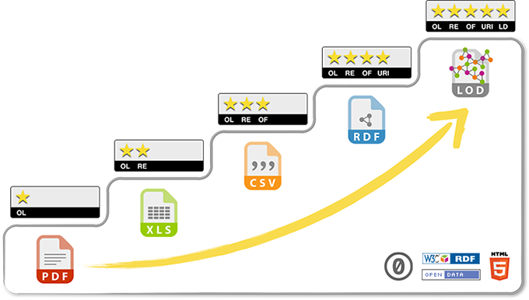
5 stars Open Data
related to other data
identified by URI
non-proprietary format
in a structured format
Data on the web, open licence
Progressing towards FAIR and Open Data requires a multidisciplinary cooperation :
Biologists
Bioinformaticians
Specialists of ontologies/semantics

Slide 12
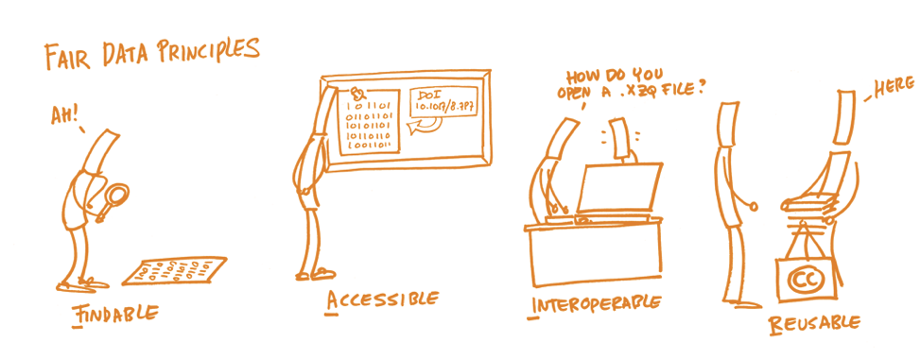
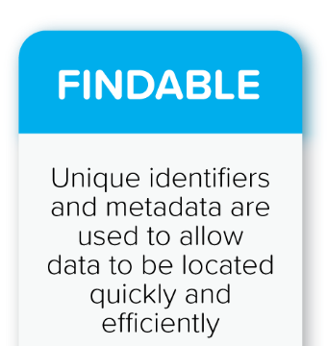

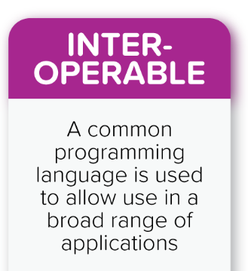
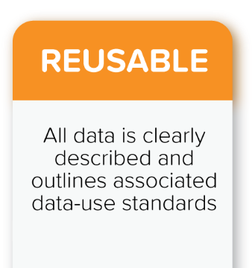

FAIR Data Principles
Wilkinson et al., The FAIR Guiding Principles for scientific data management and stewardship. Scientific Data 3 (2016)
License
Well described
Provenance
Standards
Ids
Metadata
Index
Open Protocole
Perenial Metadata
Semantics
Linked Data
Vocabularies

Slide 13
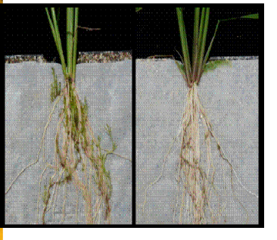
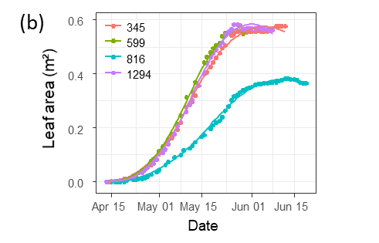
Phenotyping data life cycle
Data acquisition
Data computation
Knowledge
« Raw » data, pheno/env measures, variables
« computed » data, reduced, indicators
Soissons x high N
Charger x high N
Charger x low input
Soissons x high N
Charger x high N
Soissons x low input
Soissons x low input
Soissons x high N
Derivation, Reduction
Soissons x low input
Charger x low input
Charger x high N
Soissons x high N
Soissons x high N
Genotype | Treatment | N input | Date | Rep | Fusariose
Soissons | low input | 15,32253129 | 15/11/2011 | 1 | 5
Soissons | low input | 15,31430556 | 16/11/2011 | 2 | 7
Genotype | Treatment | Fusariose
Soissons | low input | 6

Slide 14
Phenotyping data life cycle
Knowledge
Data acquisition
Data computation
« Raw » data, pheno/env measures, variables
« computed » data, reduced, indicators
Variety charger is resistant to fusariose under intensive cultural practice
Soissons x high N
Charger x high N
Charger x low input
Soissons x high N
Charger x high N
Soissons x low input
Soissons x low input
Soissons x high N
Derivation, Reduction
Publication
Soissons x low input
Charger x low input
Charger x high N
Soissons x high N
Soissons x high N
Genotype | Treatment | N input | Date | Rep | Fusariose
Soissons | low input | 15,32253129 | 15/11/2011 | 1 | 5
Soissons | low input | 15,31430556 | 16/11/2011 | 2 | 7
Genotype | Treatment | Fusariose
Soissons | low input | 6
Wilkinson et al.
The FAIR Guiding Principles for scientific data management and stewardship.
Scientific Data 3 (2016)

Slide 15



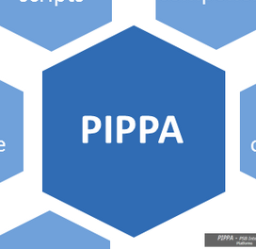

Challenges for phenomics data
Findable
Accessible
Interoperable
Distributed model: no central phenomic data archive
Agreed or compatible ID and Metadata policy
Reusable
Complex life cycle
Different types of data
Complex DMP
Compatible standards
Issues in relation with big data
Phenotype = Genotype x Environment x Cultural practice => different silos of metadata definition
Provenance is complex
Data portals
Data Archives
MCPD
Platform IS
…

Slide 16
Data standards for FAIR
Semantic
Description of the data
Controlled vocabularies: term name and definitions
Ontologies: semantic links between terms
Biologist driven
Persistent Unique Identifiers
URI, DOI, gene ID, accessions ID, Trait ID, …
Structure
Format and organize data
Data Models
Standards: CSV, VCF, GFF, MIAPPE …
Biologist & Computer scientist driven
Technical
Data integration and sharing
Interoperability: tools and systems
Computer scientist driven

Slide 17



Phenotype Standard
Semantic
Description of the data
Controlled vocabularies: term name and definitions
Ontologies: semantic links between terms
Biologist driven
Persistent Unique Identifiers
URI, DOI, gene ID, accessions ID, Trait ID, …
Structure
Format and organize data
Data Models
Standards: CSV, VCF, GFF, MIAPPE …
Biologist & Computer scientist driven
Technical
Data integration and sharing
Interoperability: tools and systems
Computer scientist driven

Slide 18
MIAPPE overview

Slide 19
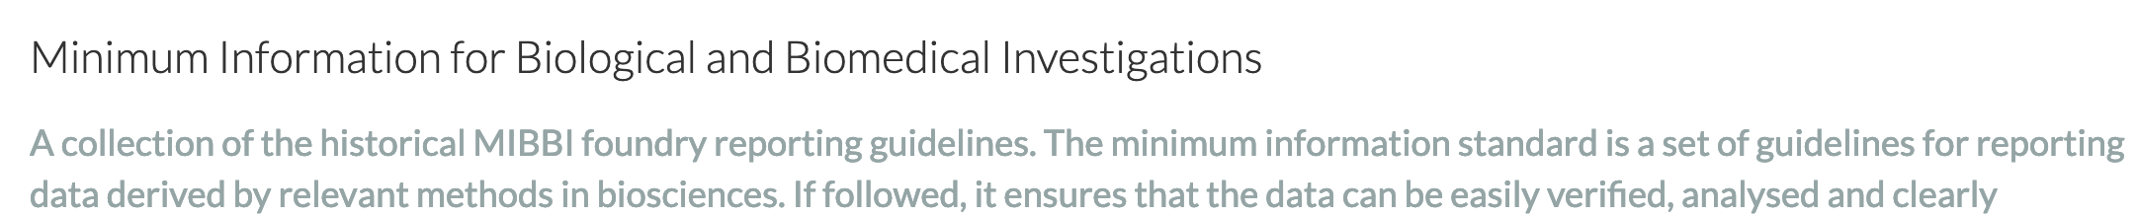
MIAPPE: Minimal Information About Plant Phenotyping Experiment www.miappe.org
Many stakeholders
Elixir, Emphasis, Bioversity, North American PPN
Open Community
Request for comments, Github Feature requests
Mailing lists
Meetings & Workgroups
Crops and woody plants - Version 1.1 (Jan 2019)
Papoutsoglou et al. (2020) Enabling reusability and interoperability of plant phenomic datasets with MIAPPE 1.1. New Phytol, https://doi.org/10.1111/nph.16544

Slide 20
MIAPPE: Minimal Information About Plant Phenotyping Experiment www.miappe.org
Biologist Friendly
Clear definitions and examples
Excel templates
Trainings
Minimal and sufficient list of metadata
Collaborating with other standards
MCPD for Biological Material identification & description
Crop Ontology for trait description
Breeding API for Web services
ISA for data exchange container, ROCrate soon

Slide 21
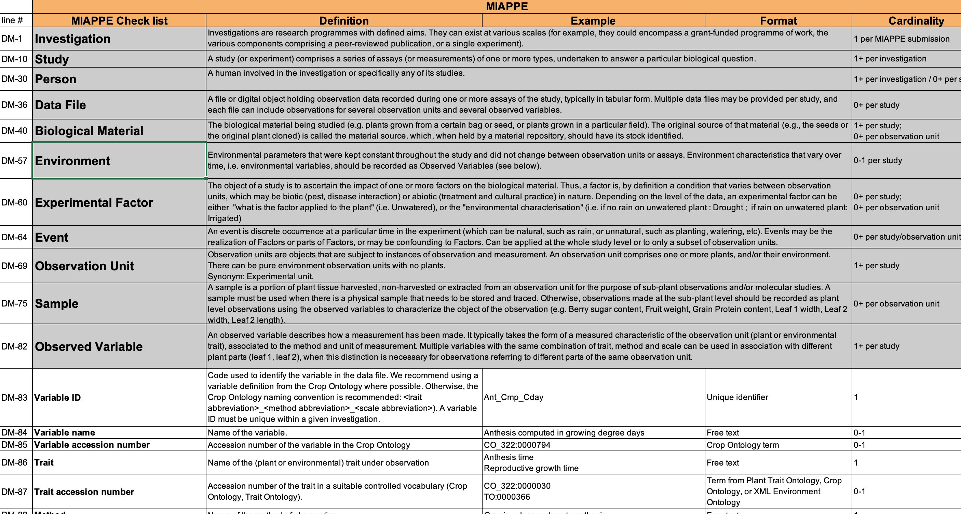
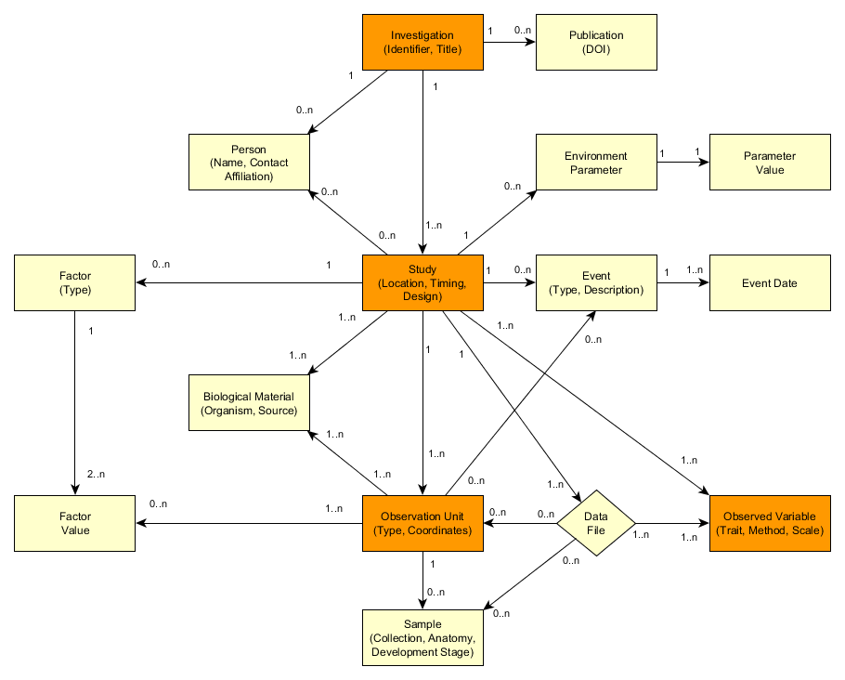
MIAPPE Specifications https://github.com/MIAPPE/MIAPPE/tree/master/MIAPPE_Checklist-Data-Model-v1.1
Specification table
Sections
Metadata Fields
Linked and organized

Slide 22
Capturing important information about phenotyping experiments using the MIAPPE standard
Two examples to illustrate how to capture important information about the phenotyping experiments:
MAIZE [1]
Millet et al. 2019 (https://doi.org/10.15454/IASSTN): A multi-site experiment in a network of European fields for assessing the maize yield response to environmental scenarios
POPLAR [2]
Monclus et al. 2012 (http://dx.doi.org/10.1186/1471-2229-12-173): Integrating genome annotation and QTL position to identify candidate genes for productivity, architecture and water-use efficiency in Populus spp

Slide 23
Millet et al 2019 [1] - Material&methods section on phenotyping experiments
A panel of 256 maize hybrids was grown with two water regimes (irrigated or rainfed).
Location: seven fields in 2012 and 2013, plus one site in Chile in 2013
This resulted in 29 experiments defined as the combination of one year, one site and one water regime, with two and three repetitions for rainfed and irrigated treatments, respectively.
A detailed environmental characterisation was carried out, with hourly records of micrometeorological data and soil water status, and associated with precise measurement of phenology.
« grain.yield»: yiel adjusted at 15% grain moisture, in ton per hectare (t ha-1). «grain.number»: number of grain per square meter. «grain.weight»: individual grain weight (mg). «anthesis»: male flowering (pollen shed), in thermal time cumulated since emergence (d20°C). «silking»: female flowering (silking emergence), in thermal time cumulated since emergence (d20°C). «plant.height»: plant height, from ground level to the base of the flag leaf (highest) leaf (cm). «tassel.height»: plant height including tassel, from ground level to the highest point of the tassel (cm). «ear.height»: ear insertion height, from ground level to ligule of the highest ear leaf (cm).

Slide 24
Monclus et al 2012 [2] - Material&methods section on phenotyping experiments
3 Field trial established in April 2003 located in France (Ardon, 47°49’41''N, 1°54’39''E, 110 m),Italy Cavallermaggiore ((44° 43' 0'' N) , (7° 41' 0'' E)), UK Headley ((51° 7' 0'' N) , (-1° 10' 0'' W) )
The biological material consisted of a cloned 336 F1 progeny from an interspecific cross between the female Populus deltoides (Bartr. Ex Marsh.) ‘73028-62’ from Illinois and the male P. trichocarpa (Torr. and Gray) ’101-74’ from Washington State.
The trial was established from 25 cm- homogenous hardwood cuttings planted at a plant density of 6670 trees per ha. The trial was and consisted in 6 randomized complete blocks where each F1 genotype and each parent was represented by one replicate.
Circumference and stem height were measured at the end of the first (winter 2003–2004) and second (winter 2004–2005) as described in Dillen et al. Forest Ecol Manag. 2007, 252 (1–3): 12-23). Growth increment in height and circumference during the second growing season were calculated.
Leaf traits where measured in 2003: one fully illuminated mature leaf was collected on each tree according to Monclus et al. http://doi.org/10.1111/j.1469-8137.2005.01407.x ). Six calibrated discs of lamina were cut from this leaf, dried at 50 °C during 48 °C and weighed, and specific leaf area (SLA, cm² g⁻¹) was computed. Leaf discs were ground to fine powder for analysis of leaf carbon isotope composition (δ¹³C), carbon (C_{M}) and nitrogen (N_{M}) contents. One-milligram subsamples of ground material were used for measuring the CO₂ produced by combustion and its ¹³CO₂/¹²CO₂ ratio by a continuous flux isotope ratio mass spectrometer. The discrimination between atmospheric CO₂ and plant material was calculated.

Slide 25
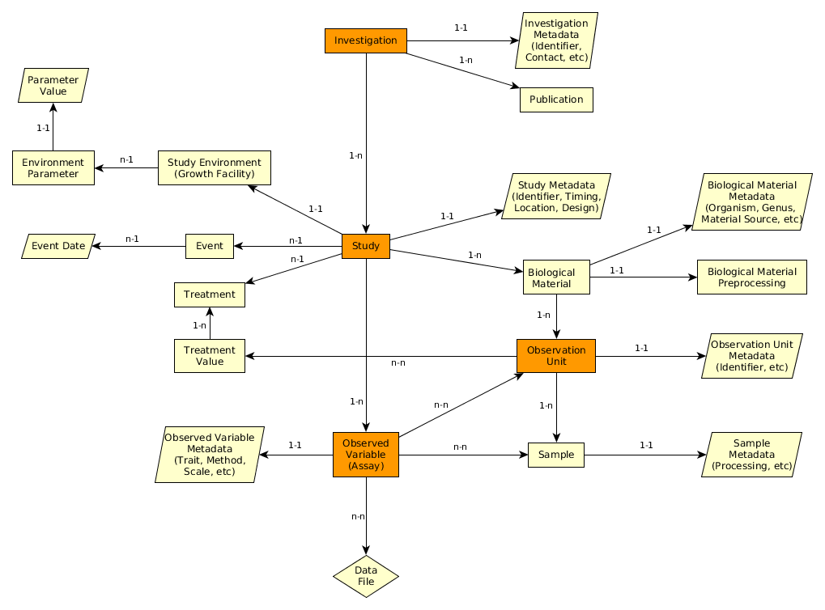
MIAPPE V1.1 Overview – The (ISA) backbone
Investigation
Study
Assay
(Observed variable)

Slide 26
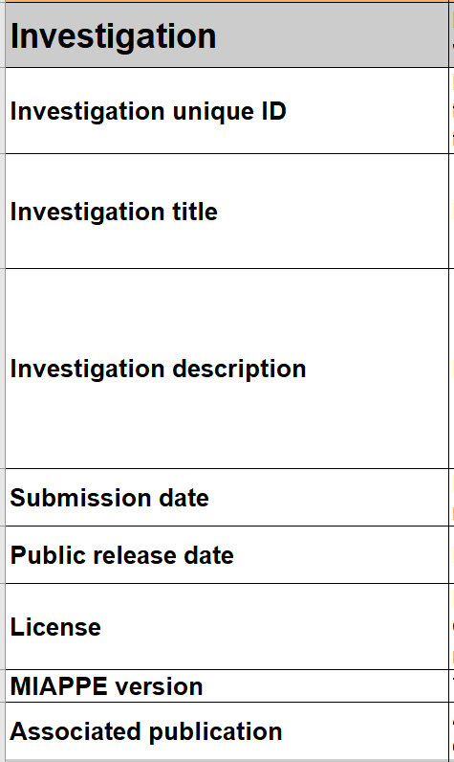
MIAPPE main sections – Investigation
Investigations are research programmes with defined aims.
They can exist at various scales: e.g. grant-funded programme of work with various published components; a single experiment.
=> One investigation holds one to many studies.
Metadata: similar to the information required for the deposition of a dataset in an archive attached to a DOI
=> title, description, associated publications/people, ...
Examples:
MAIZE [1]: the whole set of multilocal and pluriannual phenotyping experiments constitute the investigation
POPLAR [2]: the whole set of multilocal measurements over three years constitute the investigation

Slide 27
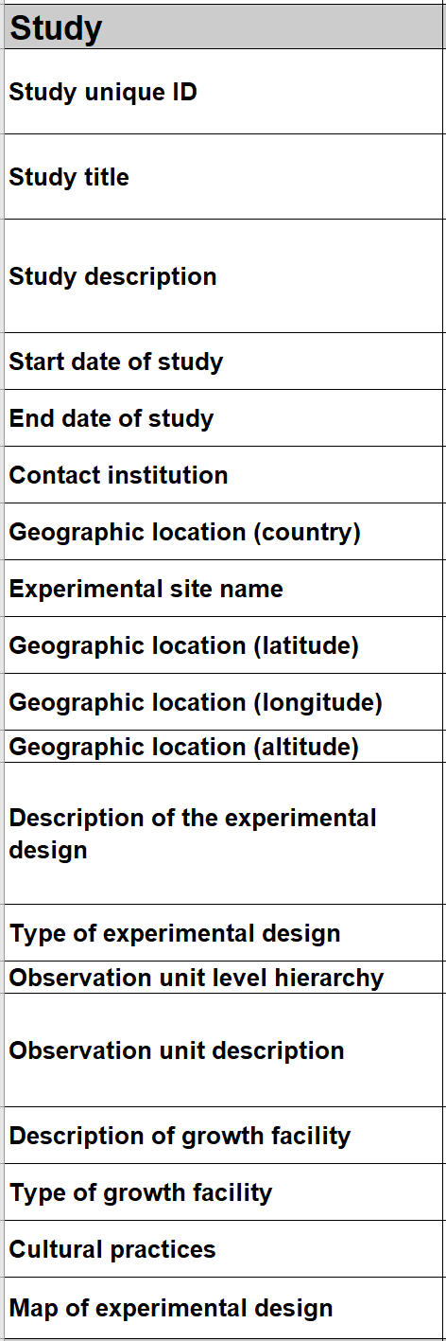
MIAPPE main sections – Study
A "study" (or experiment)
Comprises a series of assays (or measurements) undertaken to answer a particular biological question
One study = one location
Metadata: all the informations describing the experiment as a whole
=> timing, location, statistical design, cultural pratices, etc...
Examples:
MAIZE [1] : 29 studies => 2 years x 7 locations x 2 treatments (Gaillac 2012 rain, Gaillac 2013 watered, …)
POPLAR [2] : 6 studies => 3 locations over 2 years (Ardon_2003-2004, Ardon_2004-2005)

Slide 28
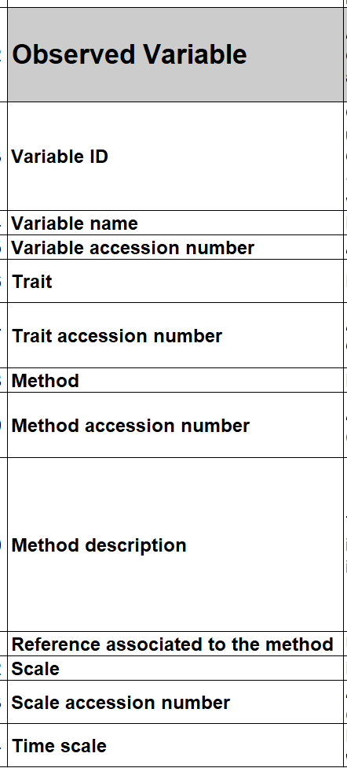
MIAPPE main sections – Observed Variable (Assay)
An Observed Variable (assay) corresponds to a specific measurement. The assay targets a trait of interest (phenotype or environment) and the measurement conducted is associated with a method and a scale
Metadata: the mandatory metadata of the Crop Ontology Trait Dictionary (trait, method and scale)

Slide 29
Crop Ontology Trait Dictionary Standard
Variable = trait + method + scale
The phenotypic observation
Trial | Genotype | CIR | HT | SUR
Domaine de Valcros | 6579 | 600 | 17 | 1
Domaine de Valcros | 6580 | 482 | 14 | 1
Variable | Variable ID
 | Variable name
 | Variable synonyms
 | Context of use
 | Growth stage
 | Variable status
 | Variable Xref
 | Institution
 | Scientist
 | Date
 | Language
 | Crop

Slide 30
Crop Ontology Trait Dictionary Standard
Variable = trait + method + scale
What is the studied character?
Trial | Genotype | CIR | HT | SUR
Domaine de Valcros | 6579 | 600 | 17 | 1
Domaine de Valcros | 6580 | 482 | 14 | 1
Trait | Trait ID
 | Trait
 | Trait class
 | Trait description
 | Trait synonyms
 | Main trait abbreviation
 | Alternative trait abbreviations
 | Entity
 | Attribute
 | Trait status
 | Trait Xref
Circumference of the tree
Total height of the tree
Survival state of the tree

Slide 31
Crop Ontology Trait Dictionary Standard
Variable = trait + method + scale
How is it observed?
Trial | Genotype | CIR | HT | SUR
Domaine de Valcros | 6579 | 600 | 17 | 1
Domaine de Valcros | 6580 | 482 | 14 | 1
Method | Method ID
 | Method
 | Method class
 | Method description
 | Formula
 | Method reference
Measured at breast height with a graduated ribbon
Measured from soil to crown with a pole or a clinometer
Visual assessment with a reference scoring scale

Slide 32
Crop Ontology Trait Dictionary Standard
Variable = trait + method + scale
How is it expressed (unit or scale)?
Trial | Genotype | CIR | HT | SUR
Domaine de Valcros | 6579 | 600 | 17 | 1
Domaine de Valcros | 6580 | 482 | 14 | 1
Scale | Scale ID
 | Scale name
 | Scale class
 | Decimal places
 | Lower limit
 | Upper limit
 | Scale Xref
 | Category 1
 | Category 2
 | …
 | Category n
cm
mm
0 = Alive
1 = Dead
2 = Doubtful

Slide 33
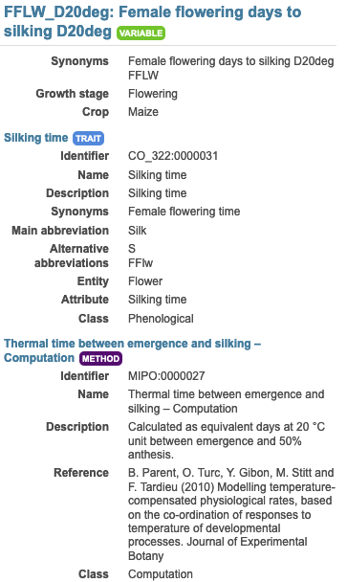
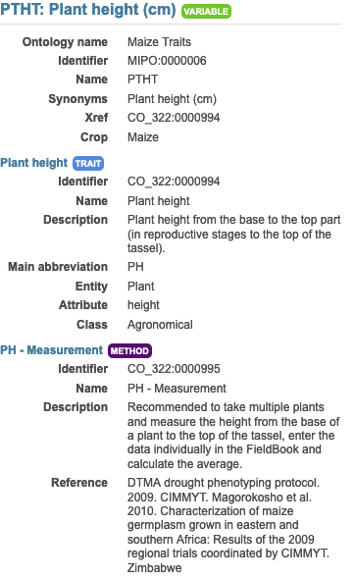
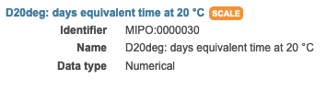
MIAPPE main sections – Observed Variable (Assay)
Example:
In each study of MAIZE [1] three measurements are made:
Plant level: 20 variables
Genotype/Study level: 19 variable both phenotype and environment
Plot level: 9 variables
For instance
Female flowering days to silking D20deg
Plant height (cm)

Slide 34
MIAPPE V1.1 Overview – The biological material
Investigation
Study
Biological material
Observation Unit
Assay
(Observed variable)
Sample

Slide 35
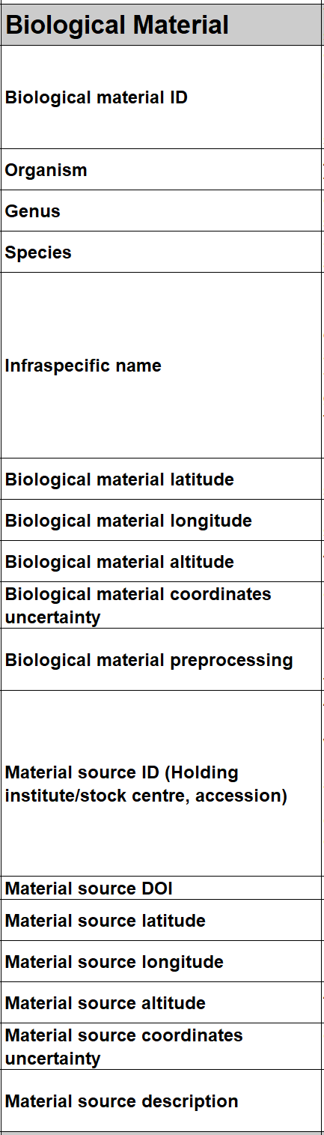
MIAPPE main sections – Biological material
Biological material identify the biological material being studied and its source (if provided originally by a stock center for instance).
=> This section is crucial for integrating phenotyping data with genomic or genetic data
Metadata:
Minimal fields from Multicrop Passport Descriptor (MCPD) standard
GPS location for forest tree / in situ material provenance

Slide 36
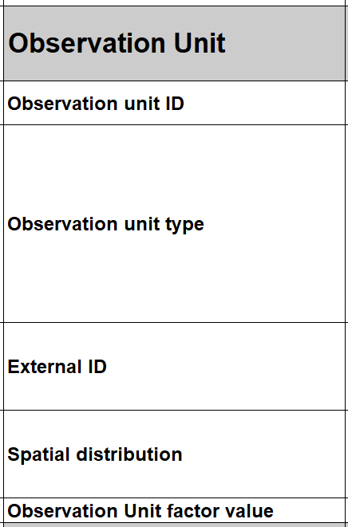
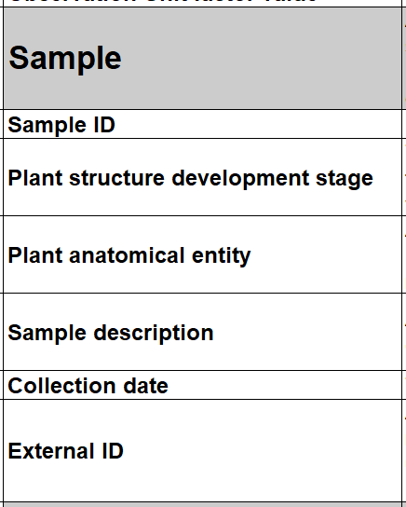
MIAPPE main sections – Observation Unit & Samples
Observation units are the objects in the study about which observations are made, and which may take different treatment values. They typically correspond to one or more individual plants. They can also be used for environmental variables.
Metadata are specific to MIAPPE
=> identifiers, location, replication, treatments, …
A sample is a portion of plant tissue extracted from an observation unit for the purpose of sub-plant observations and/or molecular studies.
Metadata are aligned with BioSample DB generic model
=> identifiers, information about processing, …

Slide 37
MIAPPE main sections – Biological material
MCPD identification system:
Genebank/Lab + Species + accession number (mandatory)
DOI
Source of the material used: accession, cultivar/variety, region of provenance, laboratory cross ...
Lab + internal accession number (mandatory)
URI
(Biological) material used in the study: seed lot, cuttings…
Lab + internal accession number (mandatory)
BioSample ID
Plant Samples used in the study: detached leaves, ...

Slide 38
MIAPPE main sections – Biological Material & Observation Unit
[Biological material]
Populus deltoïdes
INRA:73028-62
doi:10.15454/1.4921786081024297E12
Example: POPLAR [2]
[observation unit]
Populus deltoïdes
INRA:73028-62
Block1-Row4-Col4
6 randomized blocks
1 observation unit = one tree
No treatment
6 replicates defined by their position in each block: row and column

Slide 39
MIAPPE main sections – Observation Unit & Samples
Example: Monclus et al., 2012, [2]
Populus deltoïdes
INRA:73028-62
doi:10.15454/1.4921786081024297E12
[observation unit] : Block1-Row4-Col4
Set of samples
One leaf
For each tree of each block
= for each observation unit
6 leaf disks
Different types of processing of the leaf disks depending on the measurement: can be captured by different sets of samples (e.g. if subsampling generates repetitions) or in the method of the observed variable.
Notes:
Leaf traits where measured in 2003: one fully illuminated mature leaf was collected on each tree according to Monclus et al. http://doi.org/10.1111/j.1469-8137.2005.01407.x ). Six calibrated discs of lamina were cut from this leaf, dried at 50 °C during 48 °C and weighed, and specific leaf area (SLA, cm² g⁻¹) was computed. Leaf discs were ground to fine powder for analysis of leaf carbon isotope composition (δ¹³C), carbon (C_{M}) and nitrogen (N_{M}) contents. One-milligram subsamples of ground material were used for measuring the CO₂ produced by combustion and its ¹³CO₂/¹²CO₂ ratio by a continuous flux isotope ratio mass spectrometer. The discrimination between atmospheric CO₂ and plant material was calculated.

Slide 40
MIAPPE V1.1 Overview – Other important sections
Investigation
Environment
Events
Study
Biological material
Treatment
Observation Unit
Assay
(Observed variable)
Sample
Files: data,…

Slide 41
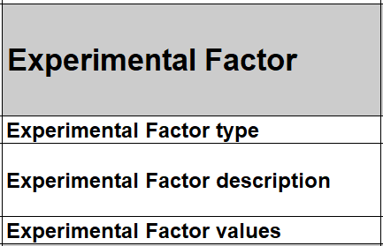
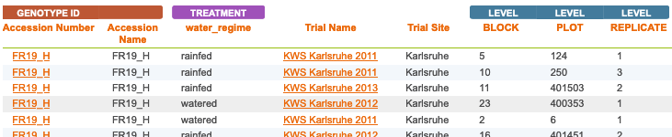
MIAPPE main sections – Experimental Factor
A treatment is a biotic or abiotic experimental factor, the effects of which are being ascertained in the study. It should take different values among the various observation units of the study.
Metadata include a name, a description and a value of the treatment
Example: MAIZE [1]
Two experimental factors/treatments: Rainfed, Watered
Block organisation

Slide 42
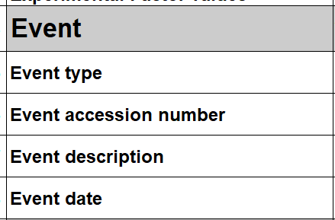
MIAPPE main sections – Event
An event is discrete occurrence at a particular time in the experiment (which can be natural, such as rain, or unnatural, such as planting, watering, etc). Can be applied at the whole study level or at the observation unit level but in the latter case, it is not the factor being studied but an additional information on the course of the experiment (e.g. unwanted pathogen attack).
Metadata include a name, a description and a time/date
Examples: POPLAR [2]
the field establishment date, 2003
the orchard was subjected to 15mm of rain on March 15, 2012 (fiction)
Study | Event
 | Name | Description | Date
Monclus et al., 2012 | Rain | 15mm of rain on the orchard | 2012-03-15

Slide 43
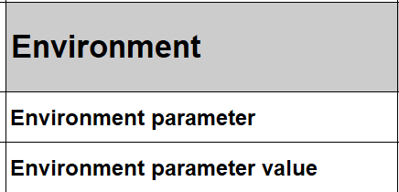
MIAPPE main sections – Environment
Environment: Environmental parameters and other experimental conditions that are controlled throughout the study and that are not a direct subject/factor of the experimentation. If the environmental variables are measured (recorded), they are described in the observed variable section.
Metadata include the description and the value of the environmental variable
Example:
Environment parameter | Environment parameter Value
Air temperature | 22°C
Rooting medium composition | Ca (XEO:00058): 5 mg/L; ...

Slide 44
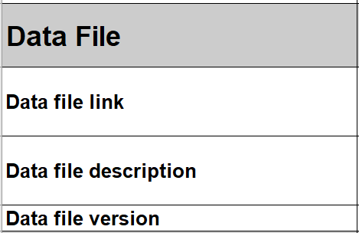
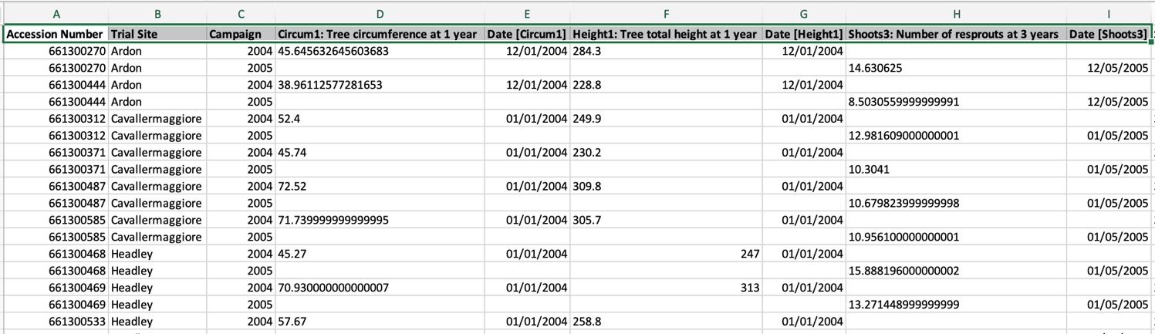
MIAPPE V1.1 Overview – Data file
Any format (Data matrix, NIRS, Images, ….)
Mostly tabular
Metadata on each column header

Slide 45
Crop ontology

Slide 46


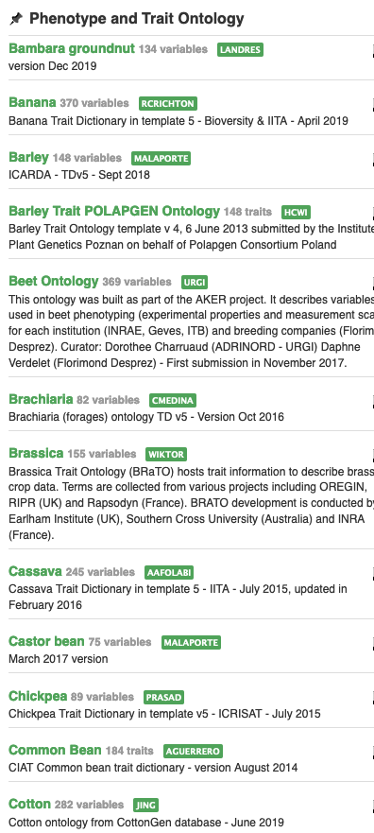
Context
Need
Importance of controlled vocabularies and ontologies for data annotation and FAIRness
Must respect crop specificities
Answer
Development of a standard to build ontologies to annotate phenotypes: “Crop Ontology”
Crop-specific vocabulary established by its community
31 ontologies crop-specific available (including woody plants): www.cropontology.org
Study | Genotype | CIR | HT | SUR
Domaine de Valcros | 6579 | 600 | 17 | 1
Domaine de Valcros | 6580 | 482 | 14 | 1
Study | Genotype | H | CIR
La Nerthe | 6579 | 23 | 650
La Nerthe | 6580 | 28 | 514

Slide 47
Standard model
Variable = trait + method + scale
The phenotypic observation
Trial | Genotype | CIR | HT | SUR
Domaine de Valcros | 6579 | 600 | 17 | 1
Domaine de Valcros | 6580 | 482 | 14 | 1
Variable | Variable ID
 | Variable name
 | Variable synonyms
 | Context of use
 | Growth stage
 | Variable status
 | Variable Xref
 | Institution
 | Scientist
 | Date
 | Language
 | Crop

Slide 48
Standard model
Variable = trait + method + scale
What is the studied character?
Trial | Genotype | CIR | HT | SUR
Domaine de Valcros | 6579 | 600 | 17 | 1
Domaine de Valcros | 6580 | 482 | 14 | 1
Trait | Trait ID
 | Trait
 | Trait class
 | Trait description
 | Trait synonyms
 | Main trait abbreviation
 | Alternative trait abbreviations
 | Entity
 | Attribute
 | Trait status
 | Trait Xref
Circumference of the tree
Total height of the tree
Survival state of the tree

Slide 49
Standard model
Variable = trait + method + scale
How is it observed?
Trial | Genotype | CIR | HT | SUR
Domaine de Valcros | 6579 | 600 | 17 | 1
Domaine de Valcros | 6580 | 482 | 14 | 1
Method | Method ID
 | Method
 | Method class
 | Method description
 | Formula
 | Method reference
Measured at breast height with a graduated ribbon
Measured from soil to crown with a pole or a clinometer
Visual assessment with a reference scoring scale

Slide 50
Standard model
Variable = trait + method + scale
How is it expressed (unit or scale)?
Trial | Genotype | CIR | HT | SUR
Domaine de Valcros | 6579 | 600 | 17 | 1
Domaine de Valcros | 6580 | 482 | 14 | 1
Scale | Scale ID
 | Scale name
 | Scale class
 | Decimal places
 | Lower limit
 | Upper limit
 | Scale Xref
 | Category 1
 | Category 2
 | …
 | Category n
cm
mm
0 = Alive
1 = Dead
2 = Doubtful

Slide 51
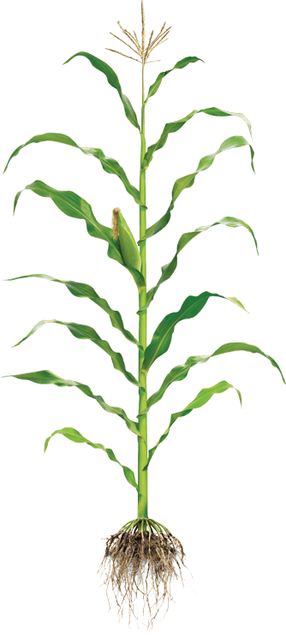
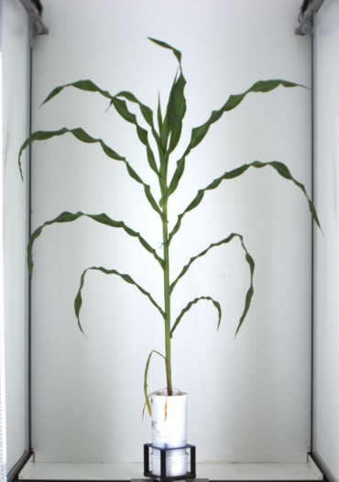

Controlled Vocabulary Challenge
Phenotyping/environment variable = Trait + Method + Unit/Scale
+
+
Trait
Method
Unit
M1: Total height
M2: First tassel branch
M3: Last expanded leaf
M4: Youngest growing leaf
U1: cm
U2: mm
We need Species specific CV/Ontologies
BUT
Near infinite number of combination
T1: Plant Height
M5: Highest pixel corresponding to plant
U3: pixel
L Cabrera

Slide 52
Controlled Vocabulary Challenge
Variable annotation
Using MIAPPE for minimal variable description
Optional reference to existing crop ontology
Ad hoc Trait or Method or Scale in MIAPPE dataset
Focus on Trait for interoperability

Slide 53
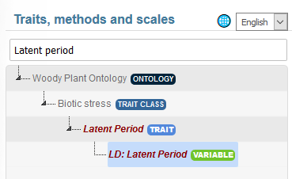
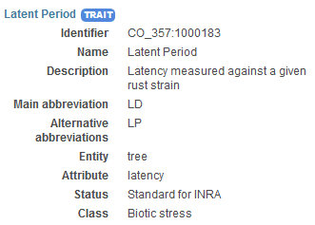
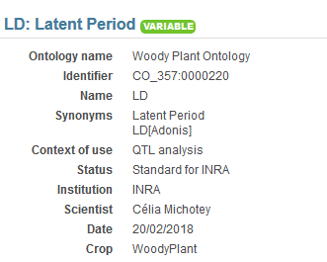
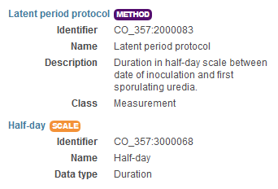
Controlled Vocabulary Challenge
Variable annotation Example 1
Trait | Trait description
L98AR1 | Latent Period for strain 98AR1
L93CV1 | Latent Period for strain 93CV1
Canker_LL | Canker lesion length

Slide 54
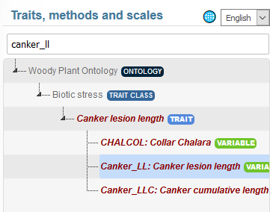





Controlled Vocabulary Challenge
Variable annotation Example 2
Trait | Trait description
L98AR1 | Latent Period for strain 98AR1
L93CV1 | Latent Period for strain 93CV1
Canker_LL | Canker lesion length
54

Slide 55
Controlled Vocabulary Challenge
Trait decomposition to Entity/Attribute
Trait = Leaf Area ➔ Entity = Leaf, Attribute = Area
Enables ad hoc controlled vocabulary + Trait Interoperability
Formalized by Mungal et al 2009
Existing in crop ontology
EMPHASIS proposition : Use for easy Variable creation and interoperability

Slide 56



Tree Variable example1 https://urgi.versailles.inra.fr/ontologyportal#termIdentifier=CO_357:0000019
1 Trait
3 Variables
3 methods

Slide 57




Tree Variable example2 https://urgi.versailles.inra.fr/ontologyportal#termIdentifier=CO_357:0000082

Slide 58


Environnemental Variable example
Variable annotation

Slide 59


Crop Variable example
Ad Hoc Variable
Trait: reference Crop Ontology Maize

Slide 60








Crop Ontology repositories and workflow
Repository, some crop ontologies
Version History
Repository, some other crop ontologies
Search over several ontologies
Trait Dictionary Template v5
Plant scientist friendly browser
https://urgi.versailles.inra.fr/ontologyportal

Slide 61
MIAPPE tools & web services: BrAPI, PPEO Ontology

Slide 62

MIAPPE File Archive
ISA Tab for Phenotyping
Investigation/Study/Assay
Zip Archive
MIAPPE Metadata
Raw data
CSV
Images or binary files
Reference to image archive (URI/URL)
Elaborated data
CSV
Provenance
Training and improvements
File and metadata curation
Elixir
Célia Miguel & Anne Françoise Adam Blondon
BrAPI to IsaTab portable tool
Elixir implementation study for MIAPPE Validation
Data files

Slide 63

MIAPPE File: Poplar Phenology dataset
Zip archive
1 investigation
i_Investigation.txt : initial file
3 Studies
3 s_*.txt file
1 level per study
3 a_*.txt
3 trait definition file
Crop ontology format
T_*.txt files
3 data files
D_*.txt file

Slide 64

MIAPPE Semantic: PPEO
MIAPPE OWL Implementation
https://github.com/MIAPPE/MIAPPE-ontology
www.MIAPPE.ORG
Data model representation
Formal concepts and constraints

Slide 65


MIAPPE Semantic: PPEO
Brapi 2 MIAPPE RDF workflow
http://ist.blogs.inra.fr/wdi/phenotypes-as-rdf/ (www.wheatIS.org data standards)
JSON LD based
Plant BrAPI ETL FAIDARE: needs update to BrAPI v1.3
https://github.com/elixir-europe/plant-brapi-etl-faidare
Wheat dataset
http://dx.doi.org/10.15454/1.4489666216568333E12

Slide 66











Phenotype Technical Standard
Breeding API http://brapi.org/
Connect data repositories and tools:
Genotype visualization (Flapjack)
Studies graph preview and filtering
BrAPPS : Tools integrable in any BrAPI compliant System
https://www.brapi.org/brapps.php
R analysis environment
Field data capture
FAIR Data discovery → Elixir FAIDARE
T3
CIRAD
GOBII
Wageningen
Cornell
iPlant
Selby et al. Bioinformatics (2019),
doi.org/10.1093/bioinformatics/btz190

Slide 67

REST - Representational State Transfer
REST is an architecture design for creating Web Services using the well known HTTP standard
Requests are made with URLs
Data is represented with JSON
BrAPI 101 Slides, P. Selby

Slide 68
Standardized Specification
BrAPI has defined a Standardized set of data model structures to communicate the basic information of plant breeding
BrAPI is a technical Specification which software developers can easily turn into code which communicates using the Standard.
BrAPI 101 Slides, P. Selby

Slide 69

BrAPI data model
MIAPPE compliant
MIAPPE Investigation → BrAPI Trial
MIAPPE Study → BrAPI Study
Biological Material Germplasm MCPD dedicated BrAPI calls
Observation variable BrAPI calls
Datafile or Observation Unit
Phenotyping
Studies
Genotyping
Studies
Germplasm
Permanent Unique Identifier (DOI)
AccessionNumber
Taxon
Institute (→ Namespace)
Observation Units
(Plants, Plots, …)
Observations
(Env, Pheno, …)
Observation Variables
Trait
Methode
Scale

Slide 70
Data repositories & Data portals
National data repositories opened for collaborators
GnpIS/data.inrae.fr
https://urgi.versailles.inra.fr/Data/Phenotyping/Data-submission
eDal!-PGP
https://edal-pgp.ipk-gatersleben.de/
BrAPI compliant databases
https://www.brapi.org/servers
Emphasis databases
PHIS, PIPPA, …
Data portals
Search over reporitories all over the world
https://urgi.versailles.inra.fr/faidare/
http://wheatis.org/Search.php

Slide 71

Take Home Message
Data integration relies on a complex lifecycle
Both:
Deriving and reducing data
Linking different datasets
All steps must be defined
→ data management plan
Not all step of data must be shared
Raw and final data should be shared
With sufficient provenance
Open science (policy): Publication and Findability are keys (Data tombs effect)
=> Standardizing your data is good for you, good for others and getting easier!

Slide 72






















Aknowledgments
Elixir Plant community & platforms
Beier S., Gruden C., Pommier C., Coppens F, Scholz U., Lange M., Contreras B., Adam Blondon AF, Faria D, Chavez I, Miguel C, Droedsbek B, Finkers R, Papoutsoglou E, Olster R, Ramsak Z, …
H2020 AGENT
N. Stein (IPK, coord), P. Kersey (RBGK), M. Alaux (INRAE), S. Weise (IPK), C. Pommier (INRAE), M. Lange (IPK), R. Finkers (WUR), J. Destin (INRAE)
MIAPPE community
ELIXIR Plant Community,
Krajewsky P, Cwiek H, Tardieu F, Usadel B, Arend D, Arnaud E, Junker A, King G, Laporte MA, Poorter H, Reif J, Rocca-Serra P, Sansone SA, Kersey P,
And many more!
Crop Ontology
Arnaud E, Laporte MA, …
Breeding API
Selby P, Mueller L, Robbins K, Backlund JE, … ,
And many more!
Emphasis
Tardieu F, Usadel B, Arend D, Junker A, Poorter H, Neveu P, Pierushka R, Shur U…
And many more!

Slide 73
Your move!
FILES
Phenotyping data
Your dataset
Test dataset: POP2_dataset.xlsx
MIAPPE template
https://github.com/MIAPPE/MIAPPE/tree/master/MIAPPE_Checklist-Data-Model-v1.1
MIAPPE_Checklist-Data-Model-v1.1.xlsx
MIAPPEv1.1_training_spreadsheet.xlsx
CropOntology
http://www.cropontology.org
TODO
Describe the dataset using MIAPPE v1.1 template

